Slide 1
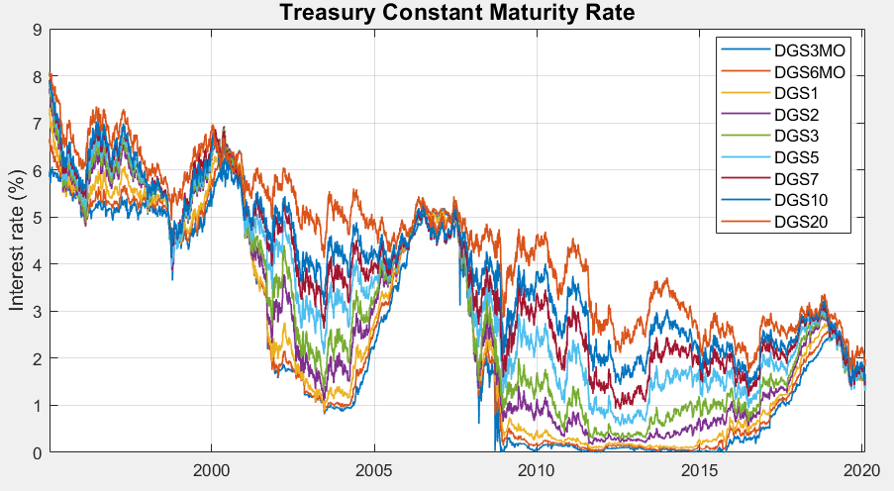
Principal Components Analysis
Yield curve data period: 01/01/1995 – 02/08/2020.

Slide 2
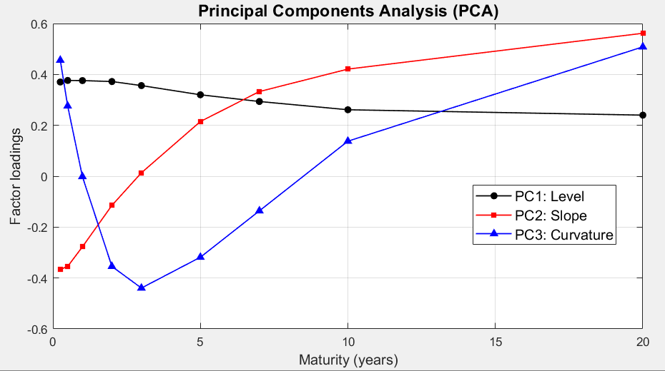
Principal Components Analysis … cont’d
Factor loadings on principal components

Slide 3
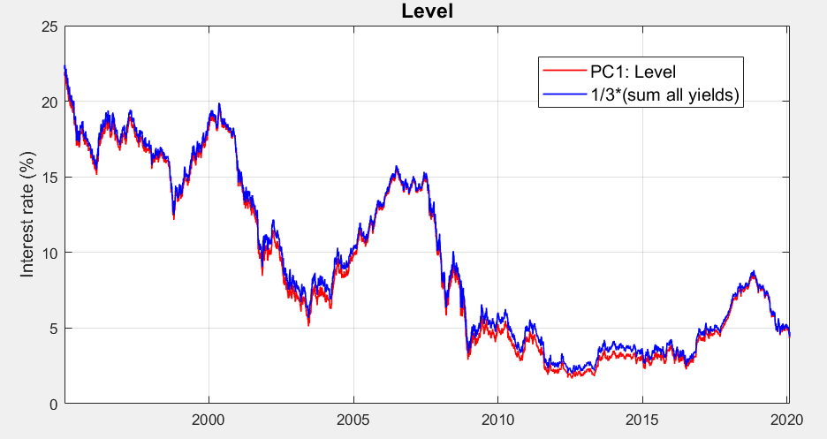
Principal Components Analysis … cont’d
PC1: Level

Slide 4
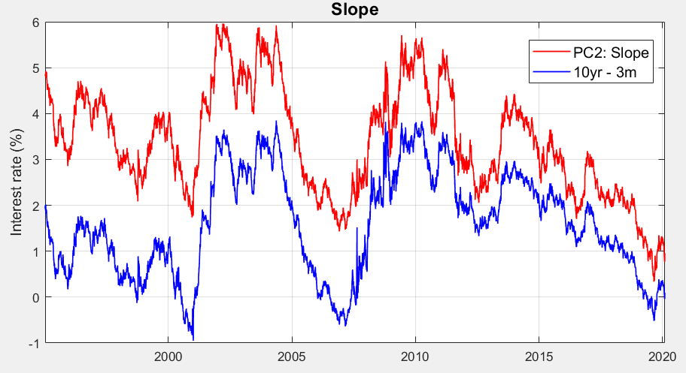
Principal Components Analysis … cont’d
PC2: Slope

Slide 5
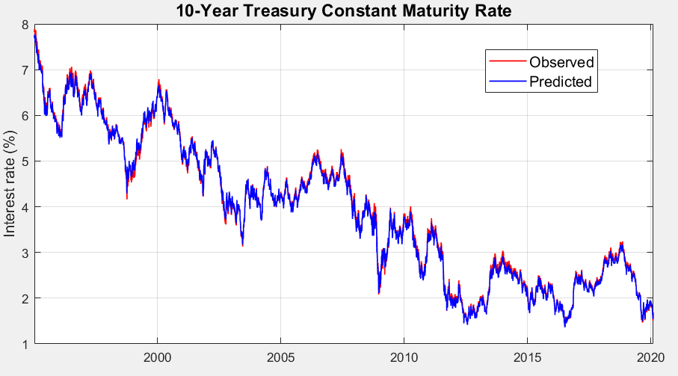
Principal Components Analysis … cont’d
Reconstruct 10-year Treasury Constant Maturity Rate with first 3 Principal Components

